Slide 1
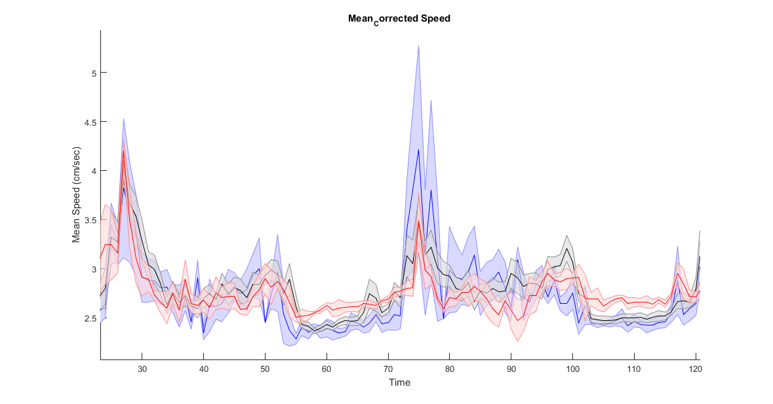
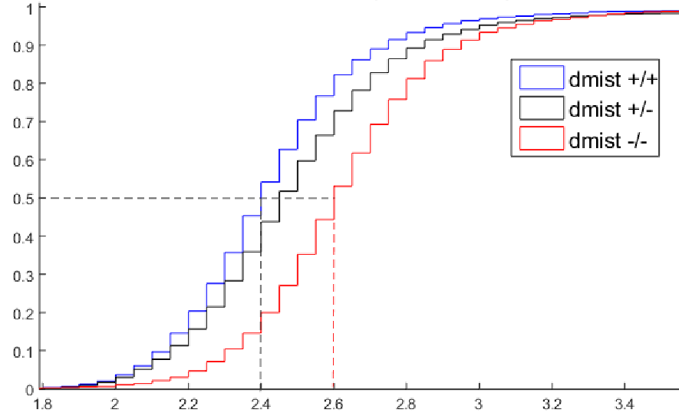
5
4.5
4
3.5
3
2.5
NIGHT
dmist +/+
dmist +/-
dmist -/-
dmist +/+
dmist +/-
dmist -/-
Mean Speed (cm/sec)
Cumulative Frequency
p=0.021, ANOVA
Day
Night
Day
Night
Mean Speed (cm/sec)
Blinded incross; raised in same tank
WT n=4
Het n=15
Mutant n=5

Slide 2
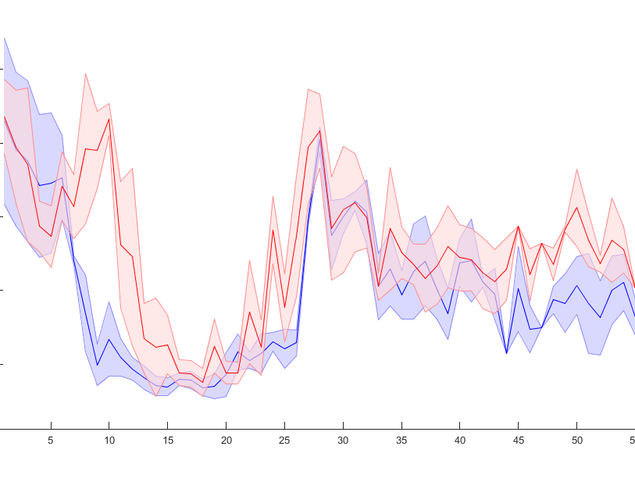
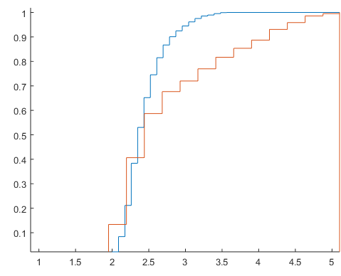
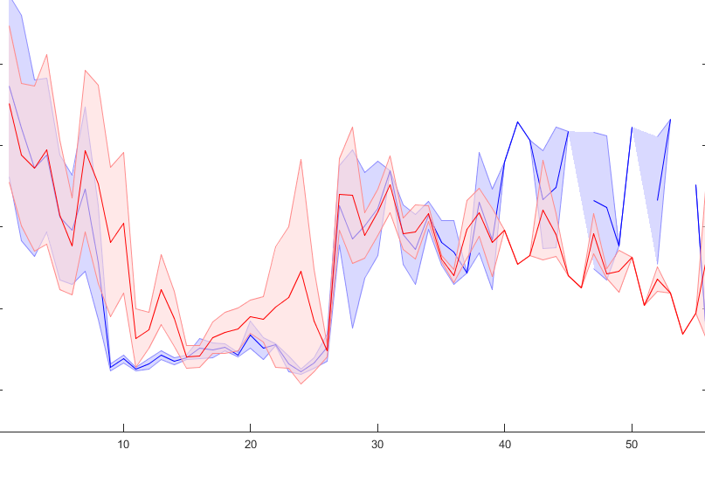
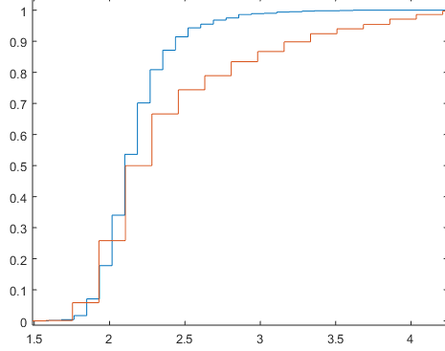
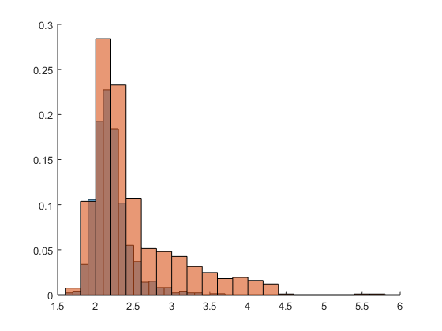
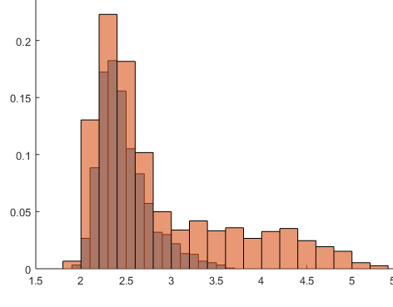
NIGHT
Male
4.5
4
3.5
3
2.5
Male
Cumulative Frequency
Mean Speed (cm/sec)
Night
Day
Mean Speed (cm/sec)
Female
NIGHT
Female
4
3.5
3
2.5
2
Mean Speed (cm/sec)
Cumulative Frequency
Night
Day
Mean Speed (cm/sec)
Males
Females
Siblings, separate tanks, WT males= 3; mut males=3; WT,F=2, MUT,F=3

